Slide 1
CS2115 Computer Organization 2023/2024 Sem A
Chapter 1: Introduction
Dr. Nan Guan
Department of Computer Science
City University of Hong Kong

Slide 2
Teaching Team
Lecturer: Dr. Nan GUAN (關楠)
Teaching all the lectures & tutorials
Office: YEUNG Y7719
Email: nanguan@cityu.edu.hk
Tutors:
Ruoxiang LI, Wenjing XIE
Teaching Assistants:
Tao HU, Yuxin DU, Ning WANG, Yu MAO, Yun HUANG, Ya YANG, Kaiwei MO
If I you don’t receive my reply in 2 days, please send it again.

Slide 3
Course Delivery
Face-to-face lectures and tutorials
Livestream and recording using ZOOM
Will not be able to interact with attendants in ZOOM
Public holidays or adversarial weather: online model via ZOOM
Public holidays:
Tutorials on Oct 2 (Week 5) and Oct 23 (Week 8)
Using Canvas for
Downloading materials, video records, announcement, project, discussions, …

Slide 4
Schedule
Week | Lecture (Wed, 09:00-11:50)
1 | Sep 6
2 | Sep 13
3 | Sep 20
4 | Sep 27
5 | Oct 4
6 | Oct 11
7 | Oct 18 (Midterm)
8 | Oct 25
9 | Nov 1
10 | Nov 8
11 | Nov 15
12 | Nov 22
13 | Nov 29
Tutorial
✓
✓
✓
✓
✓
✓
✓
✓

Slide 5
Assessment
Fina Exam: 70%
Closed-book
Continuous Assessment: 30%
Midterm: 10%
in-class, close-book
4 homework (HW)
HW4 is a group project
 | Tentative Due date* | Weight
HW 1 | Sep. 24 | 2%
HW 2 | Oct. 15 | 5%
HW 3 | Nov. 5 | 5%
HW 4 | Dec. 3 | 8%

Slide 6
Topics
Introduction
Number Systems
Circuits
ISA & Assembly
CPU
Memory
I/O & Storage
GPU & Accelerators
Performance Analysis
Advanced Topics

Slide 7
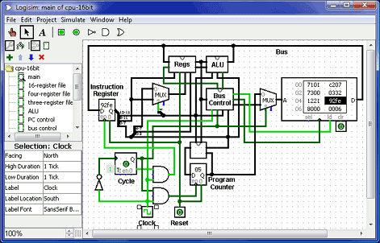
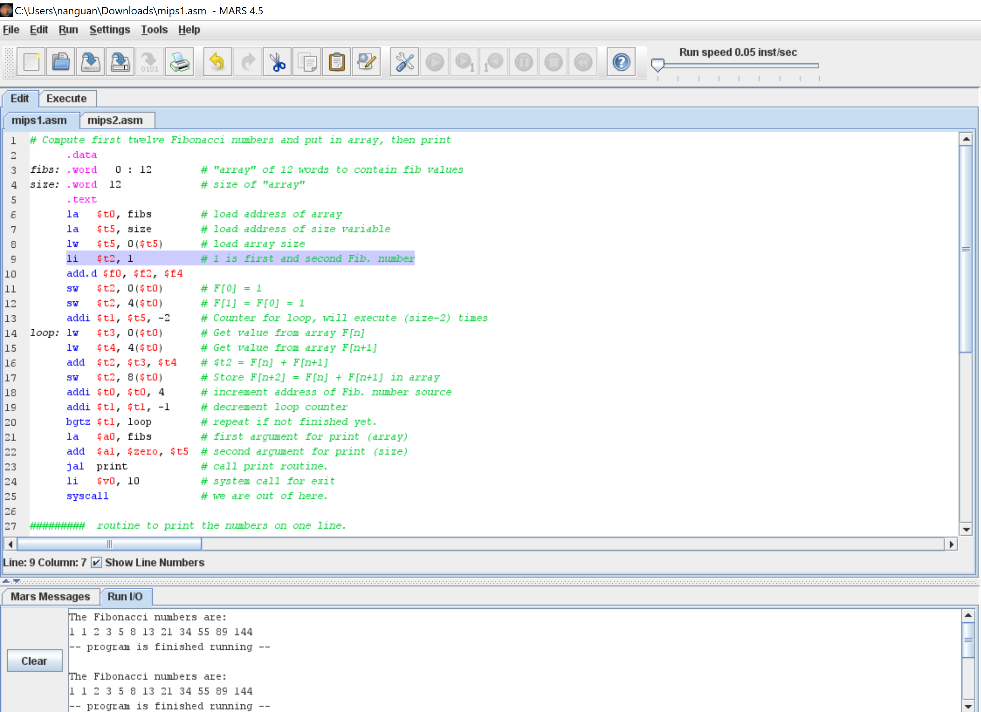
Software
Logisim
Graphical tool for designing and simulating logic circuits
Download from either Canvas or
https://sourceforge.net/projects/circuit/files/
https://github.com/logisim-evolution/logisim-evolution/releases
MARS
MIPS Assembler and Runtime Simulator
Download from either Canvas or
https://courses.missouristate.edu/KenVollmar/mars/MARS_4_5_Aug2014/Mars4_5.jar
Has both Windows and MacOS versions, as well as java executable
java executable
Download JRE: https://www.oracle.com/java/technologies/downloads

Slide 8
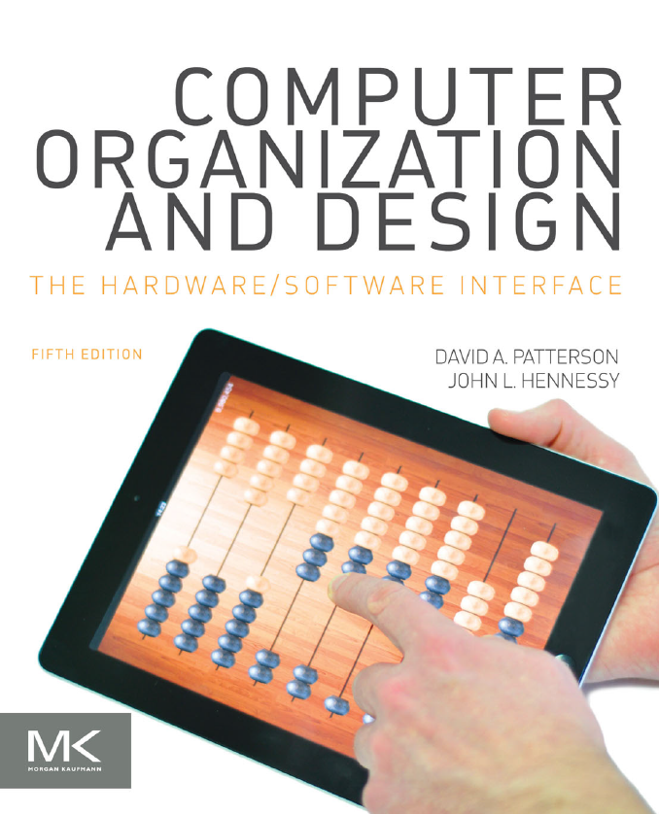
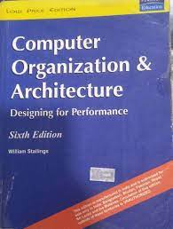
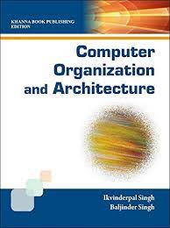
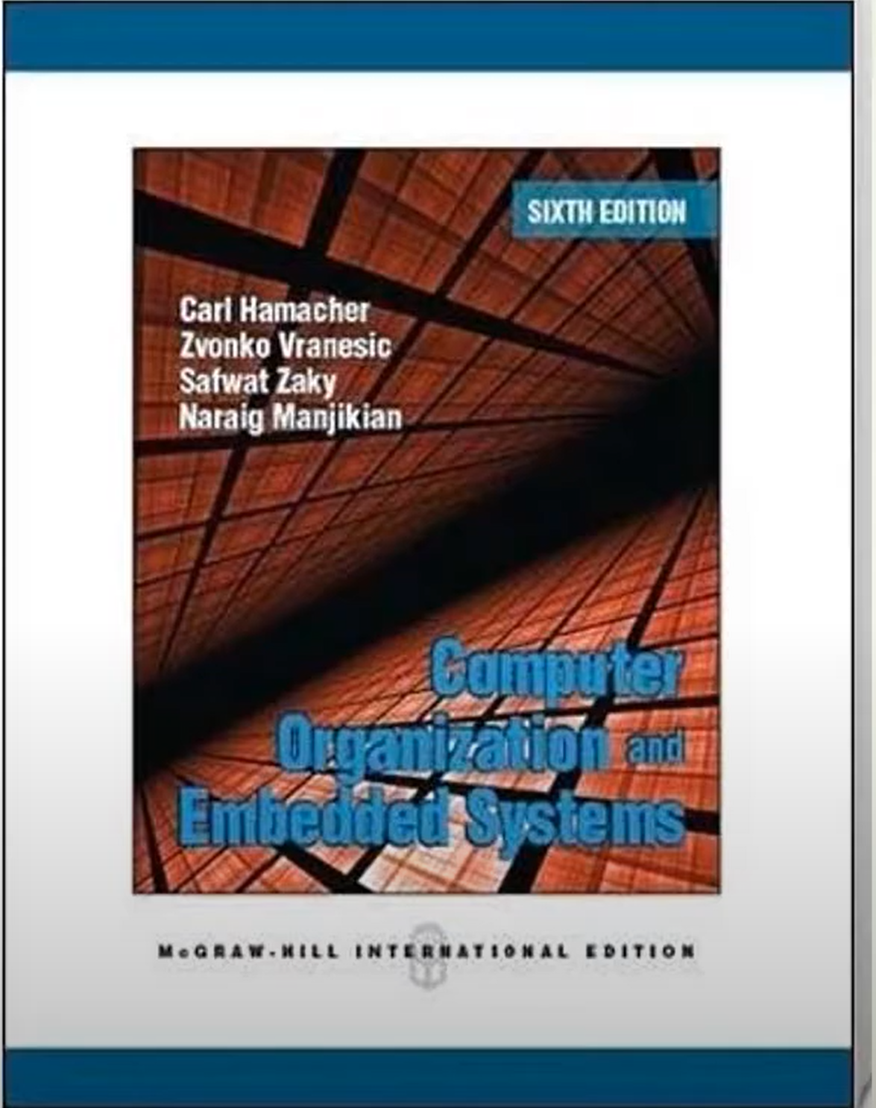
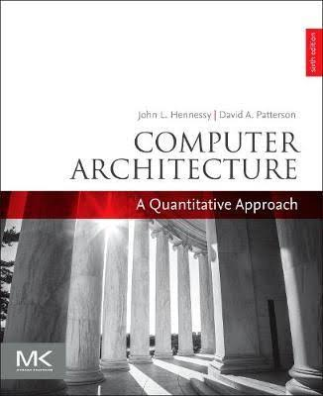
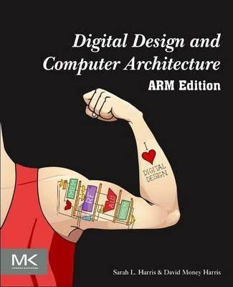
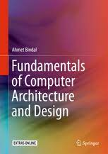
Textbook & Readings

Slide 9
You are expected to
Attend all lectures and tutorials
Start to do your HW/project early and finish them in time
Late submissions not accepted
No cheating or plagiarism in any exam and HW
Penalty to the giver and receiver
Subject to disciplinary actions
Be active and have your own ideas/opinions
Give me your feedback as much as possible
https://forms.gle/7bGthqA8CPL14kou6

Slide 10
What is This Course About
This course is all about how computers work
What is a computer?
Different types: desktop, laptop, server, embedded computer …
Different uses: automobiles, finance, game, scientific computing …
Different vendors: Intel, Apple, IBM, HP, Dell …
…
We both learn general principles and discuss specific instances
We also try to “design” a simple computer by ourselves

Slide 11
Why do We Learn This Course
Computer scientists/engineers should understand computers
Many other people can use computers and even write codes, but has little idea of how a computer actually works
Develop software with high performance
Performance: synergy between software and hardware
Choose the right computer to do a job
And, invent better computers
Higher performance, lower cost, lower energy consumption …

Slide 12
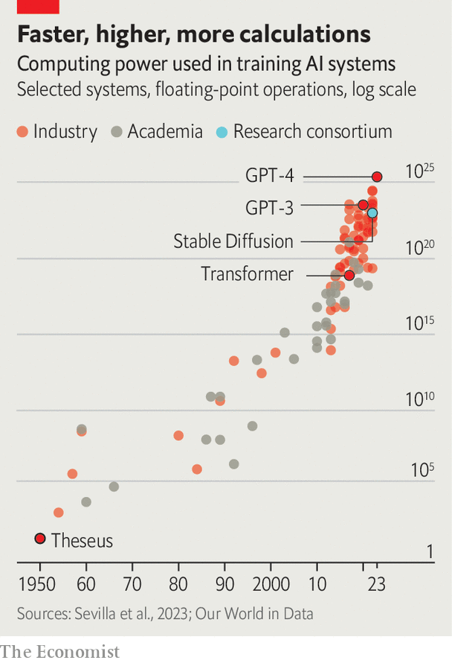
Why do We Learn This Course
The ABC of AI Era
AI = Algorithms + Big Data + Computing
Computing
Big Data
Algorithms

Slide 13
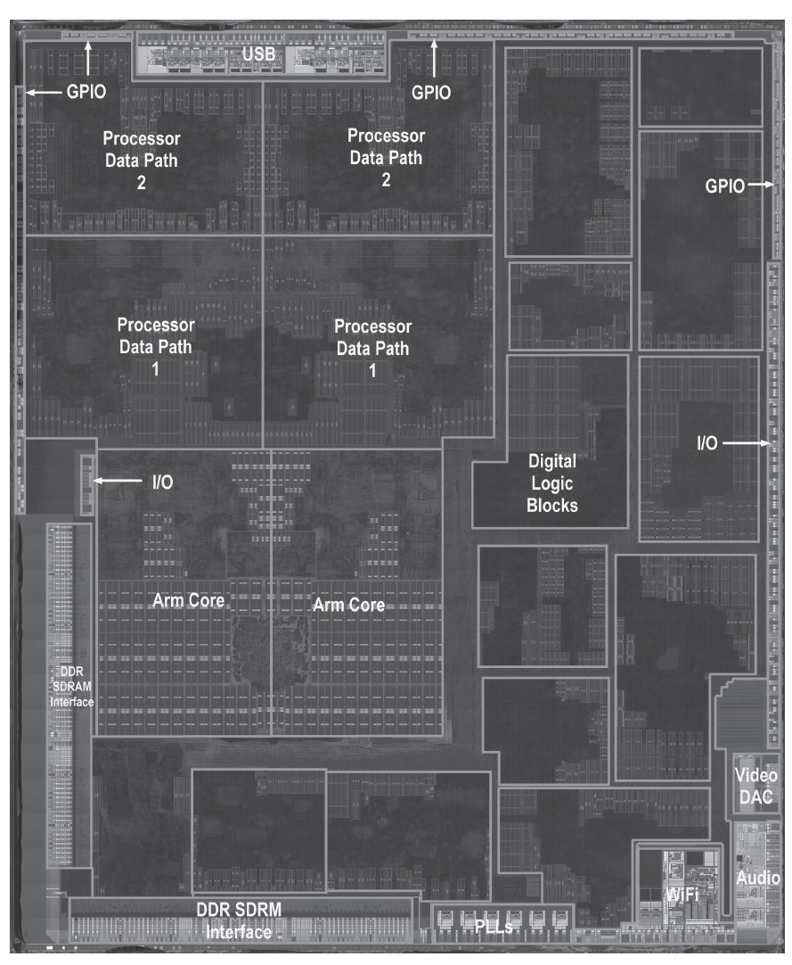
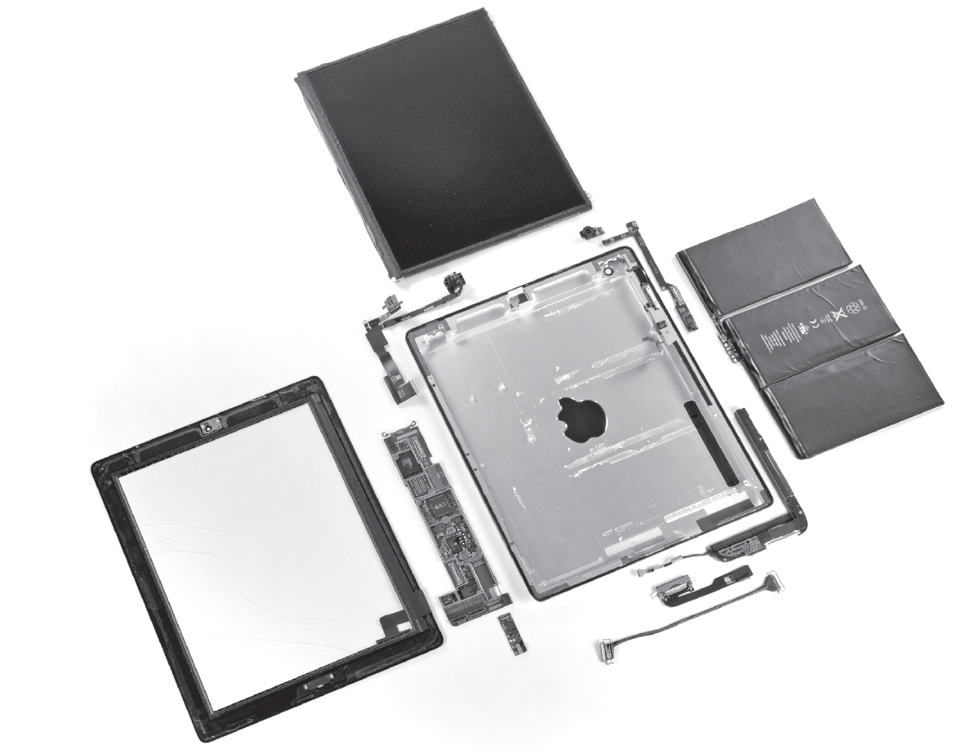
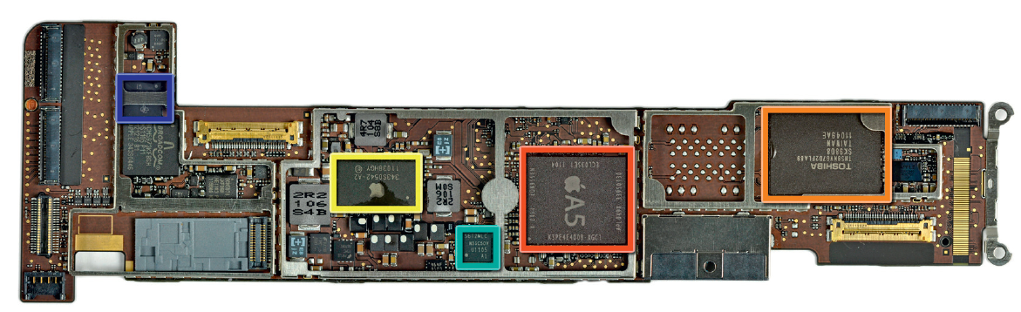
Open the Box
Components of the Apple iPad 2 A1395
The processor integrated circuit inside the A5 package
The logic board of Apple iPad 2

Slide 14
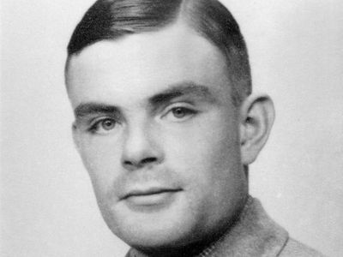
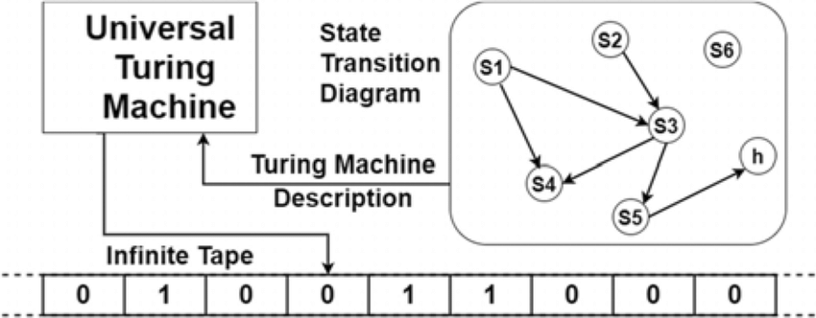

Turing Machine
Alan Turing
1912 - 1954
“It is possible to invent a single machine which can be used to compute any computable sequence.”

Slide 15





Organization of a Computer
Memory
Control
Datapath
11001001001001
Input
1001
110010
010010
011100
010010
011100
010010
011100
John von Neumann
1903 – 1957
“I am thinking about
something much more
important than bombs.
I am thinking about
computers.”
1011
Processing
11011001101010
Output
“von Neumann Architecture”

Slide 16
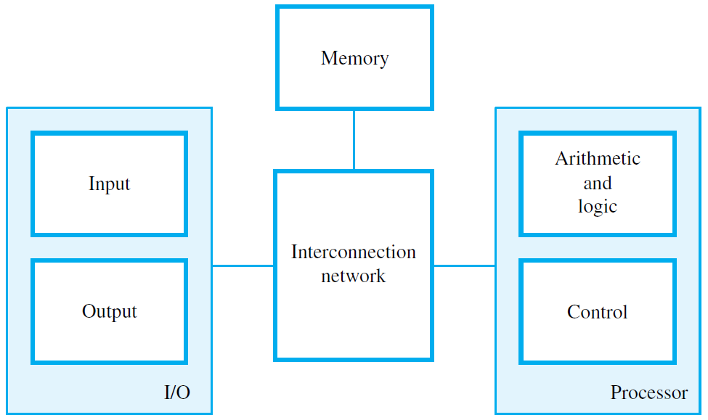
Common Functional Units

Slide 17
Common Functional Units
logic circuits for performing arithmetic and logic operations on word-size data operands
timing and control circuits for fetching program instructions and data from memory, one after another
registers (typically 16, 32 or 64 bits), each of which hold one word of operand data

Slide 18
Common Functional Units
Primary memory (Main memory):
semiconductor bit cells, organized into words (e.g., 32 bits)
programs and their data must be in this memory to be executed
Secondary memory
magnetic and optical disks, flash mem. Devices …
permanently store program and data files
Cache memory
much smaller and faster than the main memory; holds parts of the program and data currently executed
adjunct to the main memory, fabricated on the processor chip
cache

Slide 19
Common Functional Units
Input: Typical devices – keyboard, touchpad, mouse, microphone, camera, …
Output: Typical devices – text and graphics displays, printers, …

Slide 20
Common Functional Units
Bus (data bus, address bus) and the controller

Slide 21
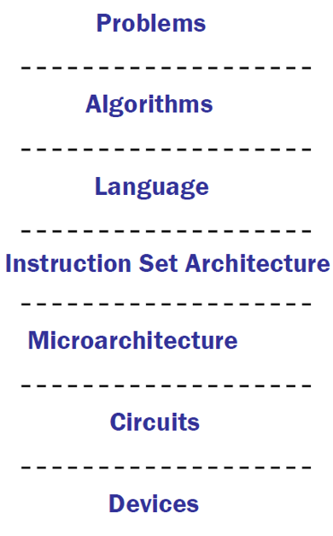
Layered View of Computers
Applications
Software Design:
choose algorithms and data structures
Programming:
use language to express design
Compiling/Interpreting:
convert language to machine instructions
Processor Design:
choose structures to implement ISA
Logic/Circuit Design:
gates and low-level circuits to implement components
Process Engineering & Fabrication:
develop and manufacture lowest-level components
Transistors

Slide 22
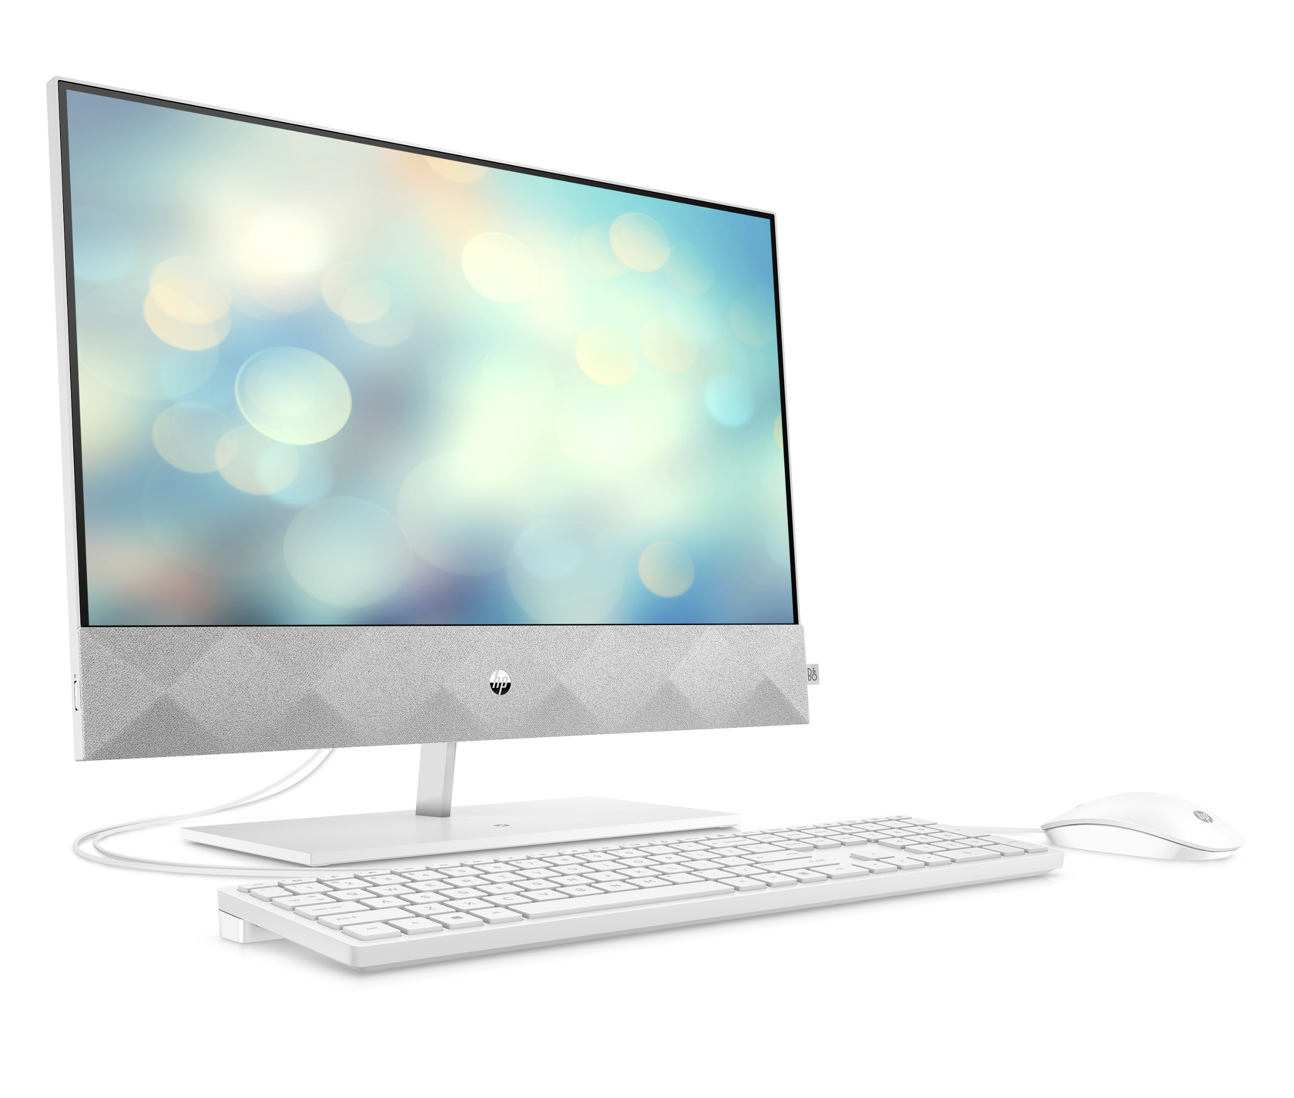
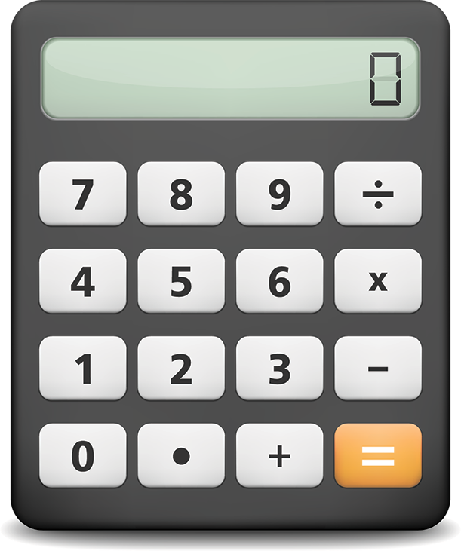
Discussion
What are the differences between these two devices?

